Slide 1


PCRN Disaster Preparation and Response Workshop – Suva, Fiji, 2-4 October 2017
Responding to a major disaster – lessons from cyclone PAM
Ettienne Ravo
Assistant Registrar General

Slide 2
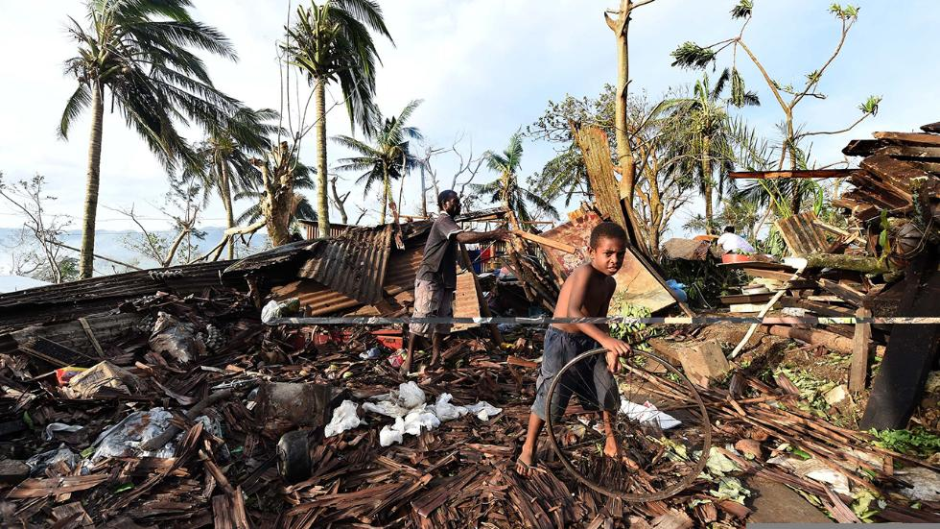
Introduction & Country Back Ground
Vanuatu is an island nation of 271,089 people
There are 6 provinces with 14 main inhabited islands
70% of the population live in the Rural areas with few living in traditional lifestyles and having little interaction with government.
Civil Registry Department is under the Ministry of Internal Affairs
Registration is compulsory, but has largely not been enforced.

Slide 3
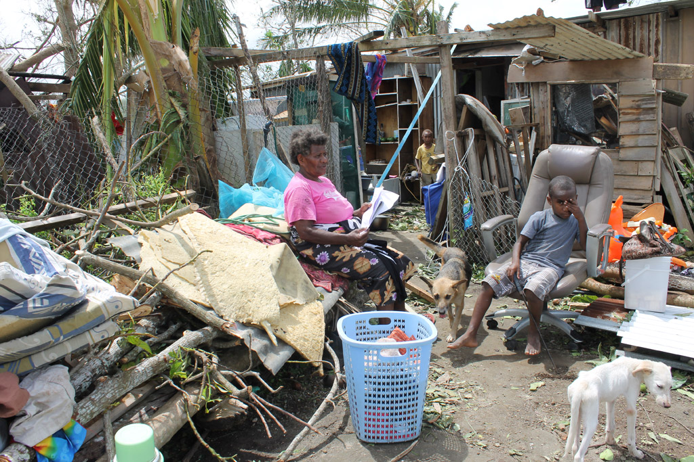
Tropical Cyclone PAM
TC PAM Pounded in the northern part of Vanuatu and the Eastern part of Solomon islands for one week in early March this year 2015, and then creped slowly down south through the Vanuatu archipelago for three days and three nights.
Left behind in its wake, wreckages of infrastructures, disabling all basic Services and destructions to homes, telecommunication net work services, properties and environmental wreckage.

Slide 4
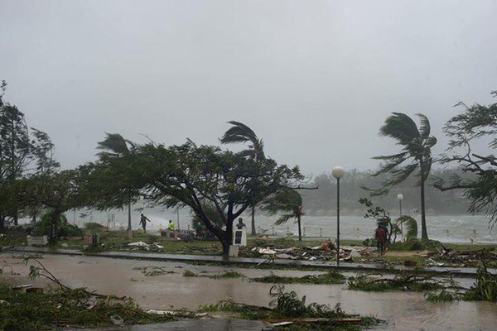
Tropical Cyclone PAM
First time Vanuatu experienced a category 5 cyclone.
Most affected areas are in the central Provinces and the Southern Province. Those living in slums around Port Vila are the ones mostly affected.
Despite the strength, density and coverage and destruction of many homes, only 13 people died including one child.
Minimum number of deaths many experiences in facing cyclones in the past, and our formal and informal resilience systems. These include early warning systems and tracking of the cyclone, and preparedness by the people of Vanuatu to face the cyclone.

Slide 5
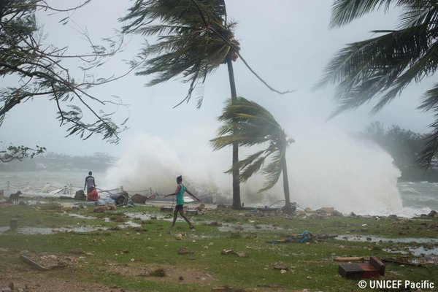
Tropical Cyclone PAM Damaged Caused
188,000 people affected.
96% of agricultural crops Wiped Out in affected areas.
65,000 people displaced from their homes.
81% of homes in affected areas sustained some damage.

Slide 6
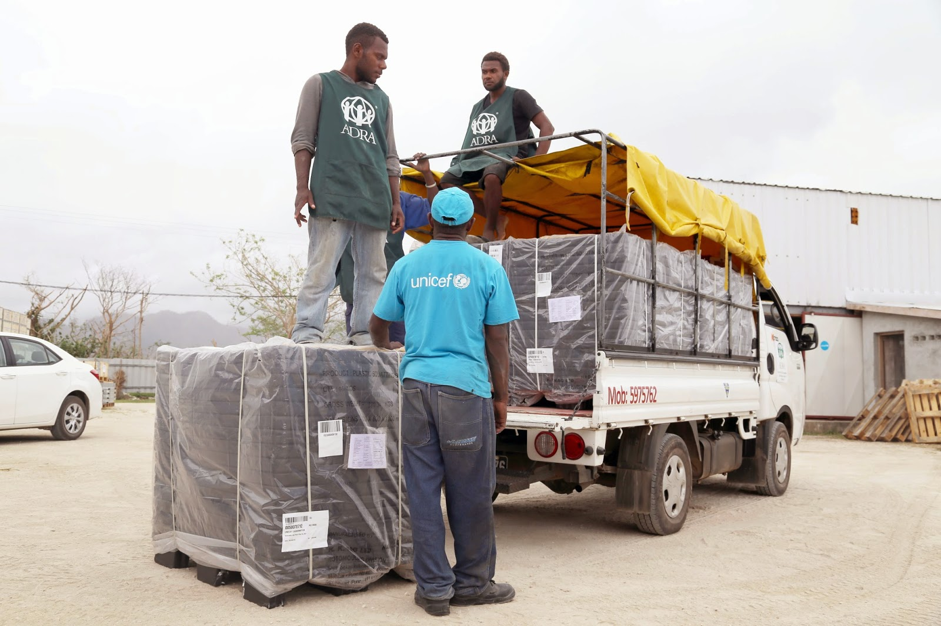
Tropical Cyclone PAM Response
Rapid assessments indicated vital
documents including birth certificates were destroyed or lost.
MOIA/CRO mobilized partners with support from the Gender & Protection Cluster & National & Provincial CRVS Committees.

Slide 7
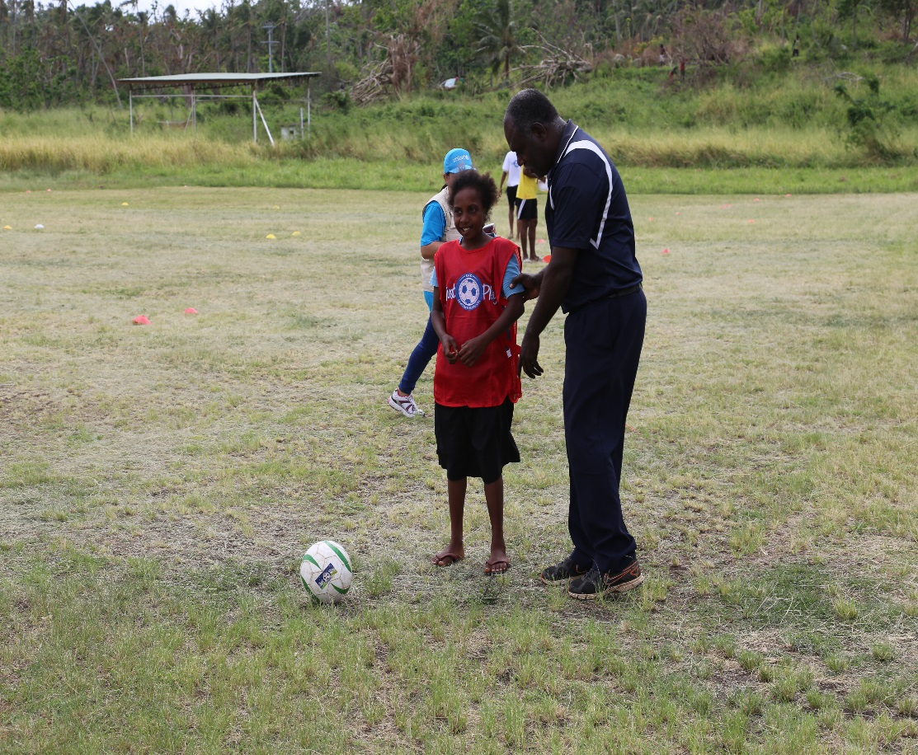
Tropical Cyclone PAM Response
500++ personal were involved in all six provinces.
Mass awareness campaigns were conducted on radio,
SMS,TV, Community meetings etc.
BR Campaign launched on 24th April 2015 on Tanna island, Tafea Province.

Slide 8
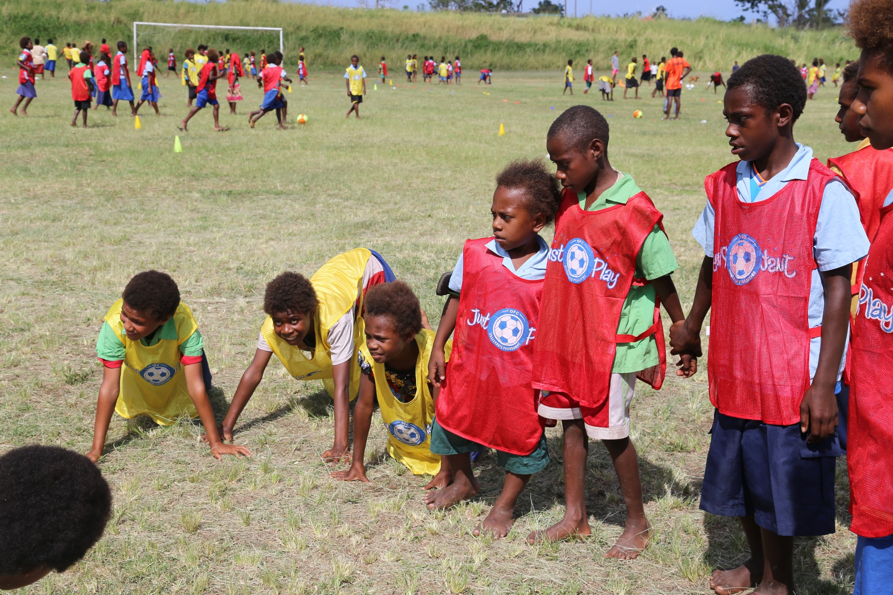
Tropical Cyclone PAM Response

Slide 9
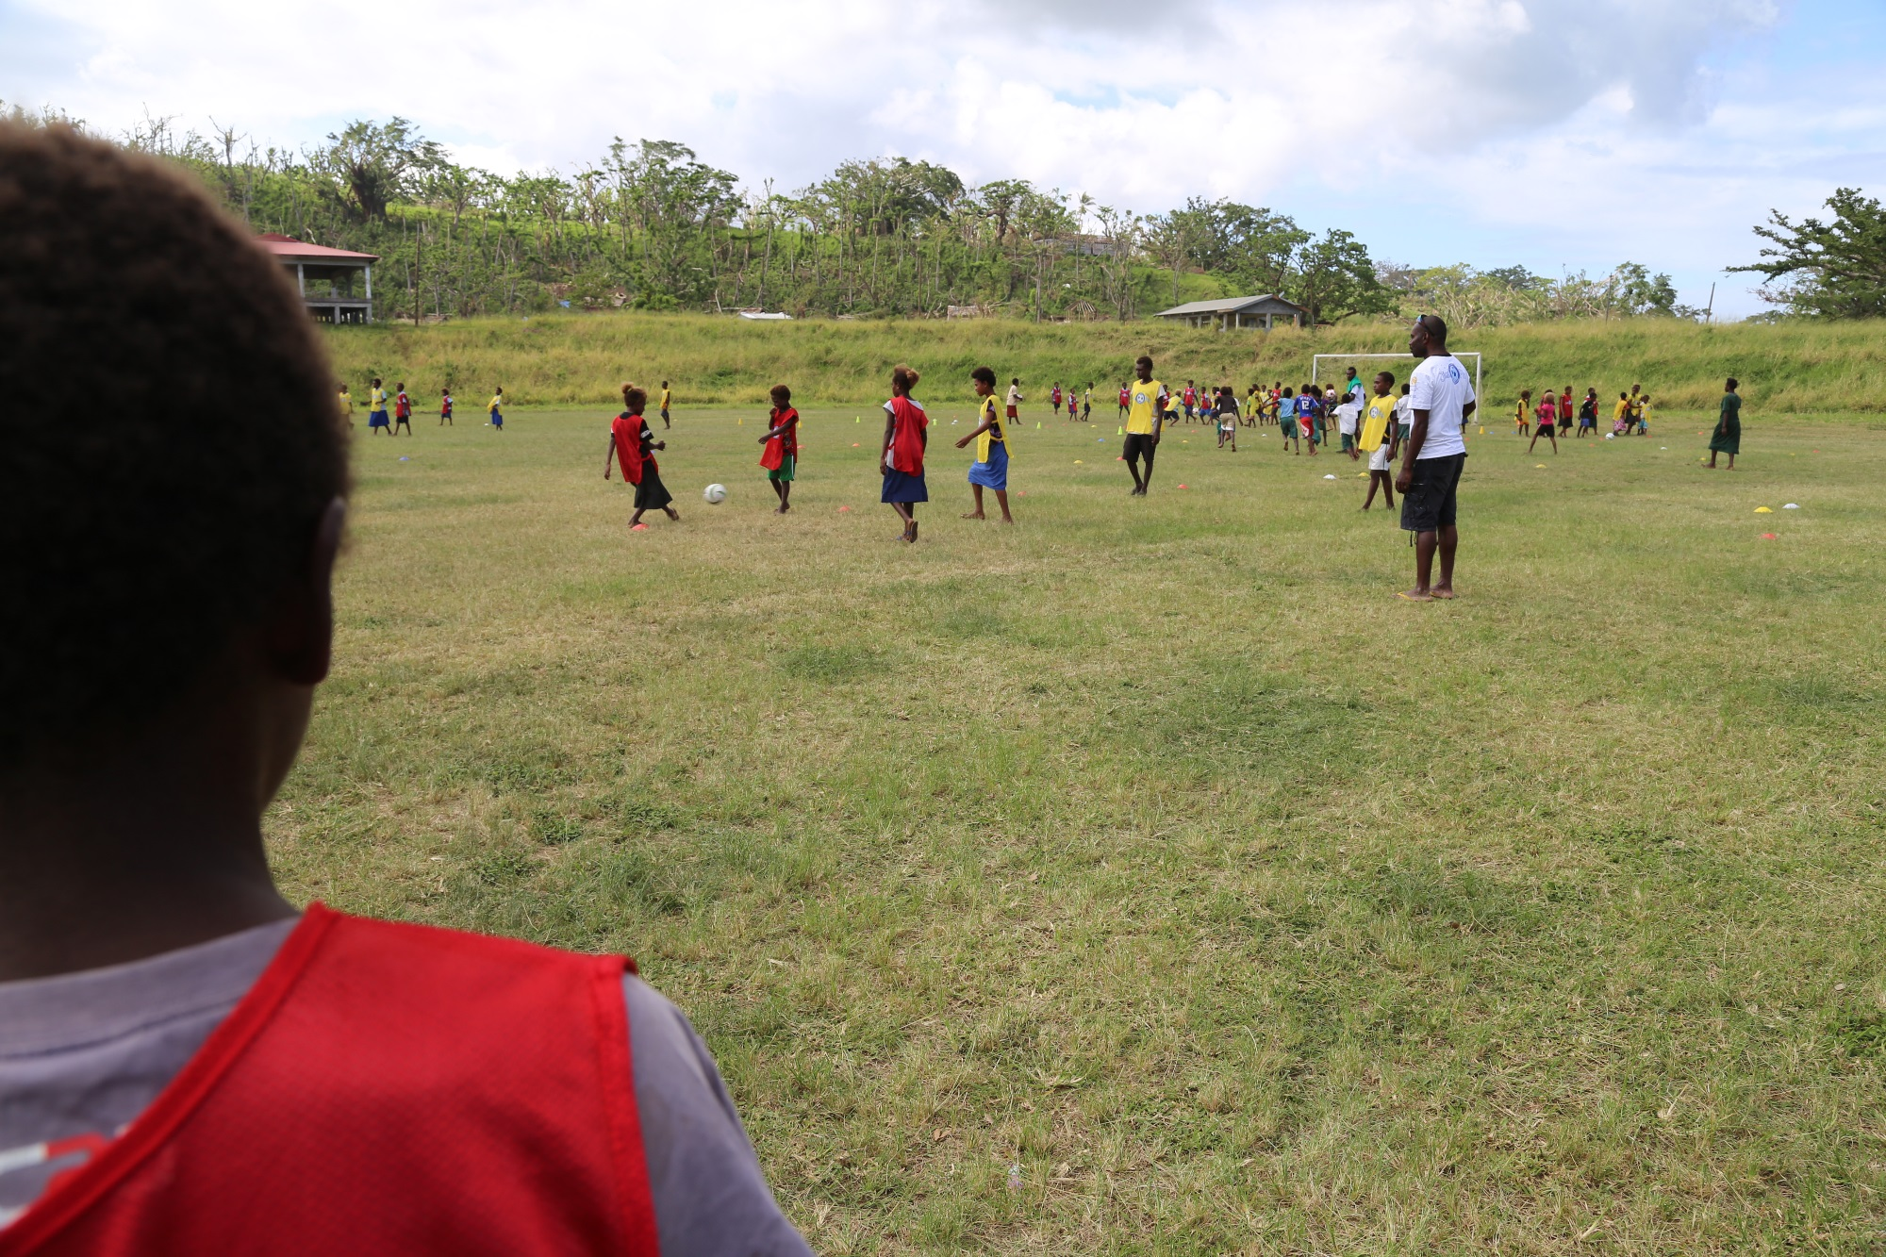
Tropical Cyclone PAM Response

Slide 10
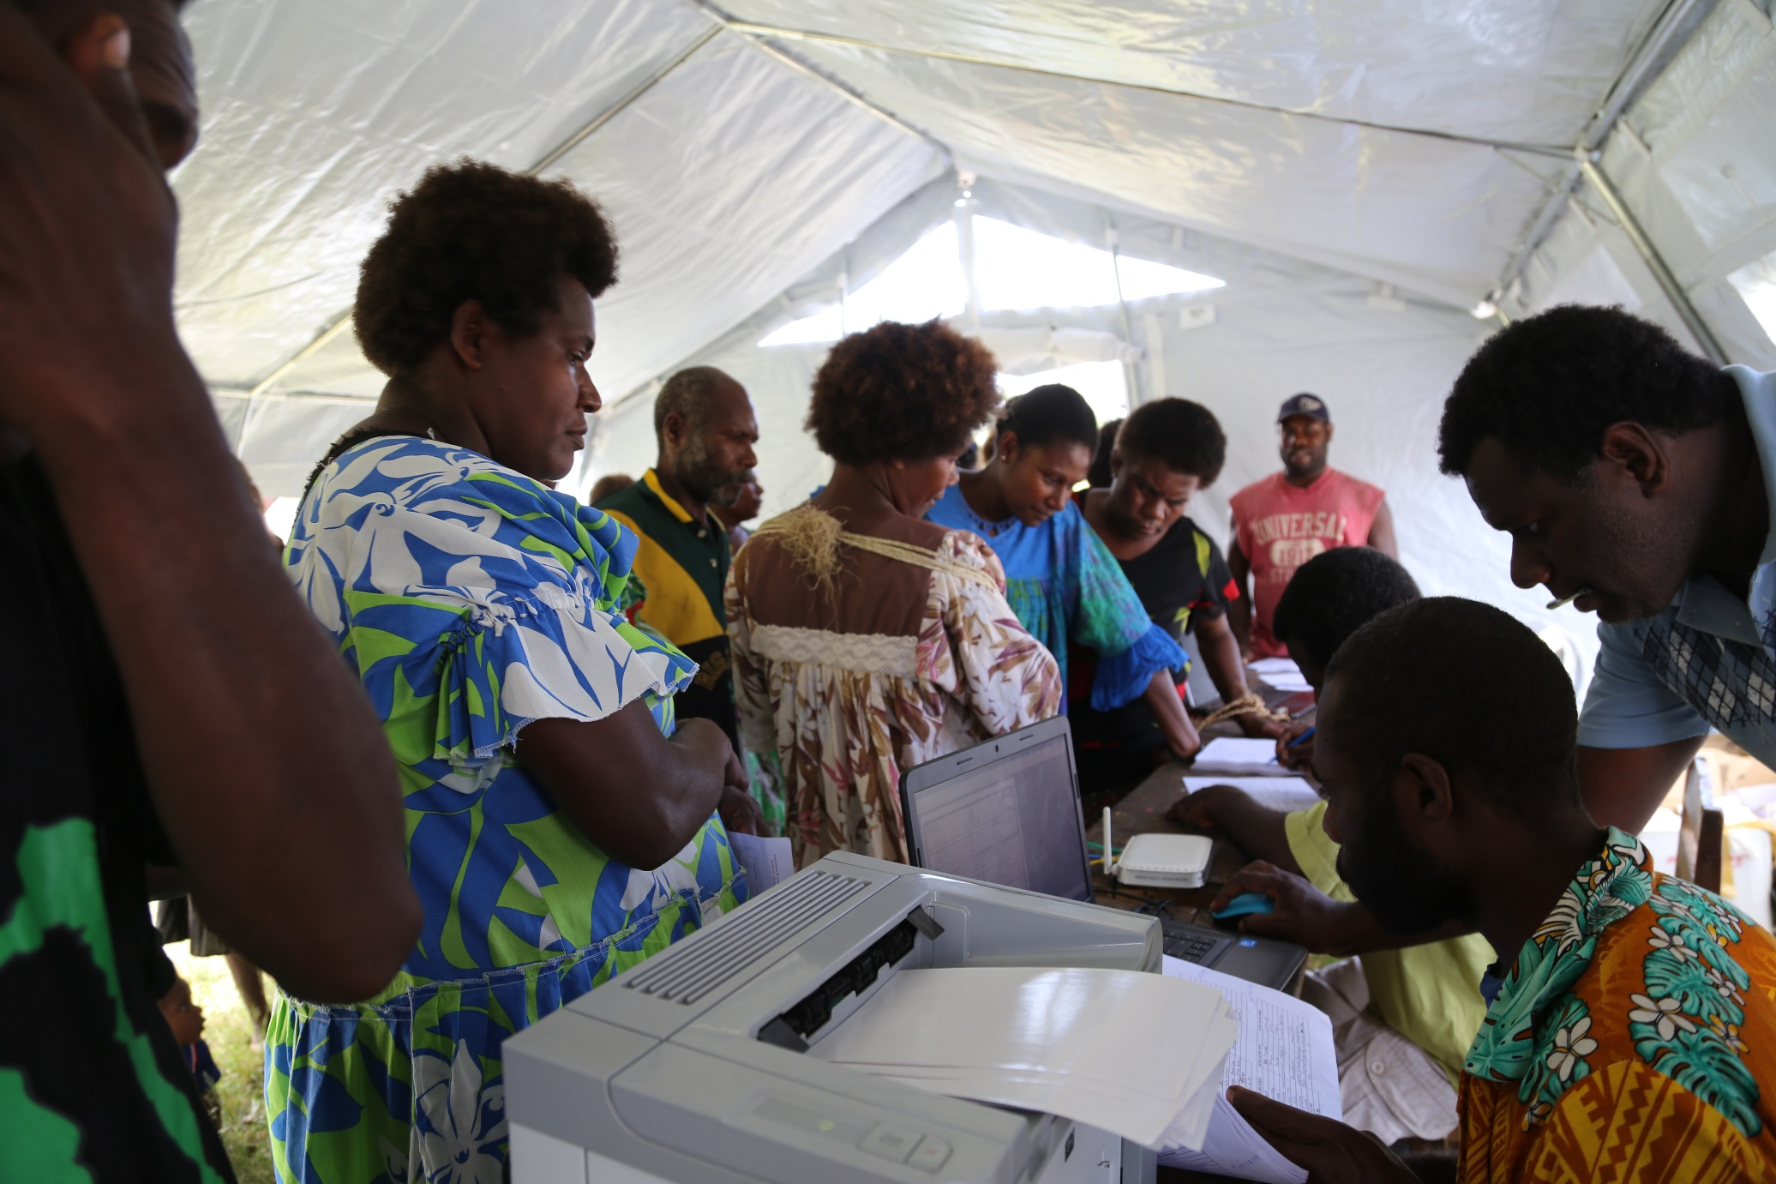
Tropical Cyclone PAM Response

Slide 11
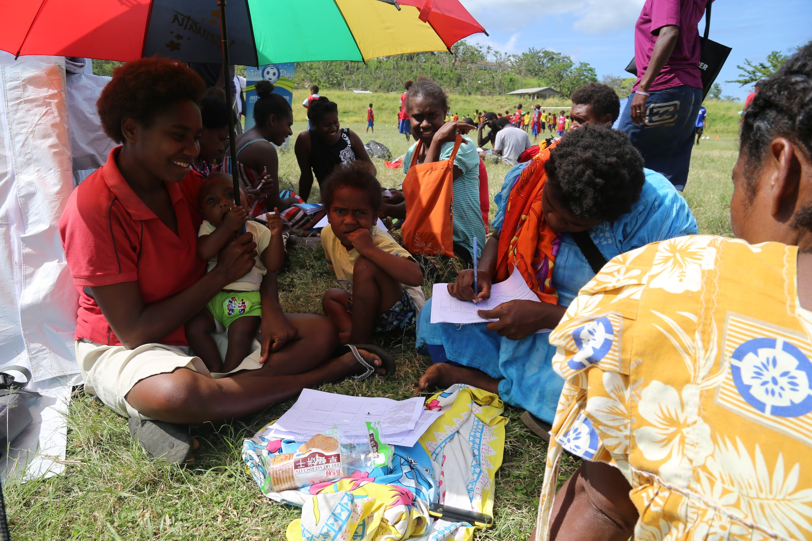
Tropical Cyclone PAM Response

Slide 12
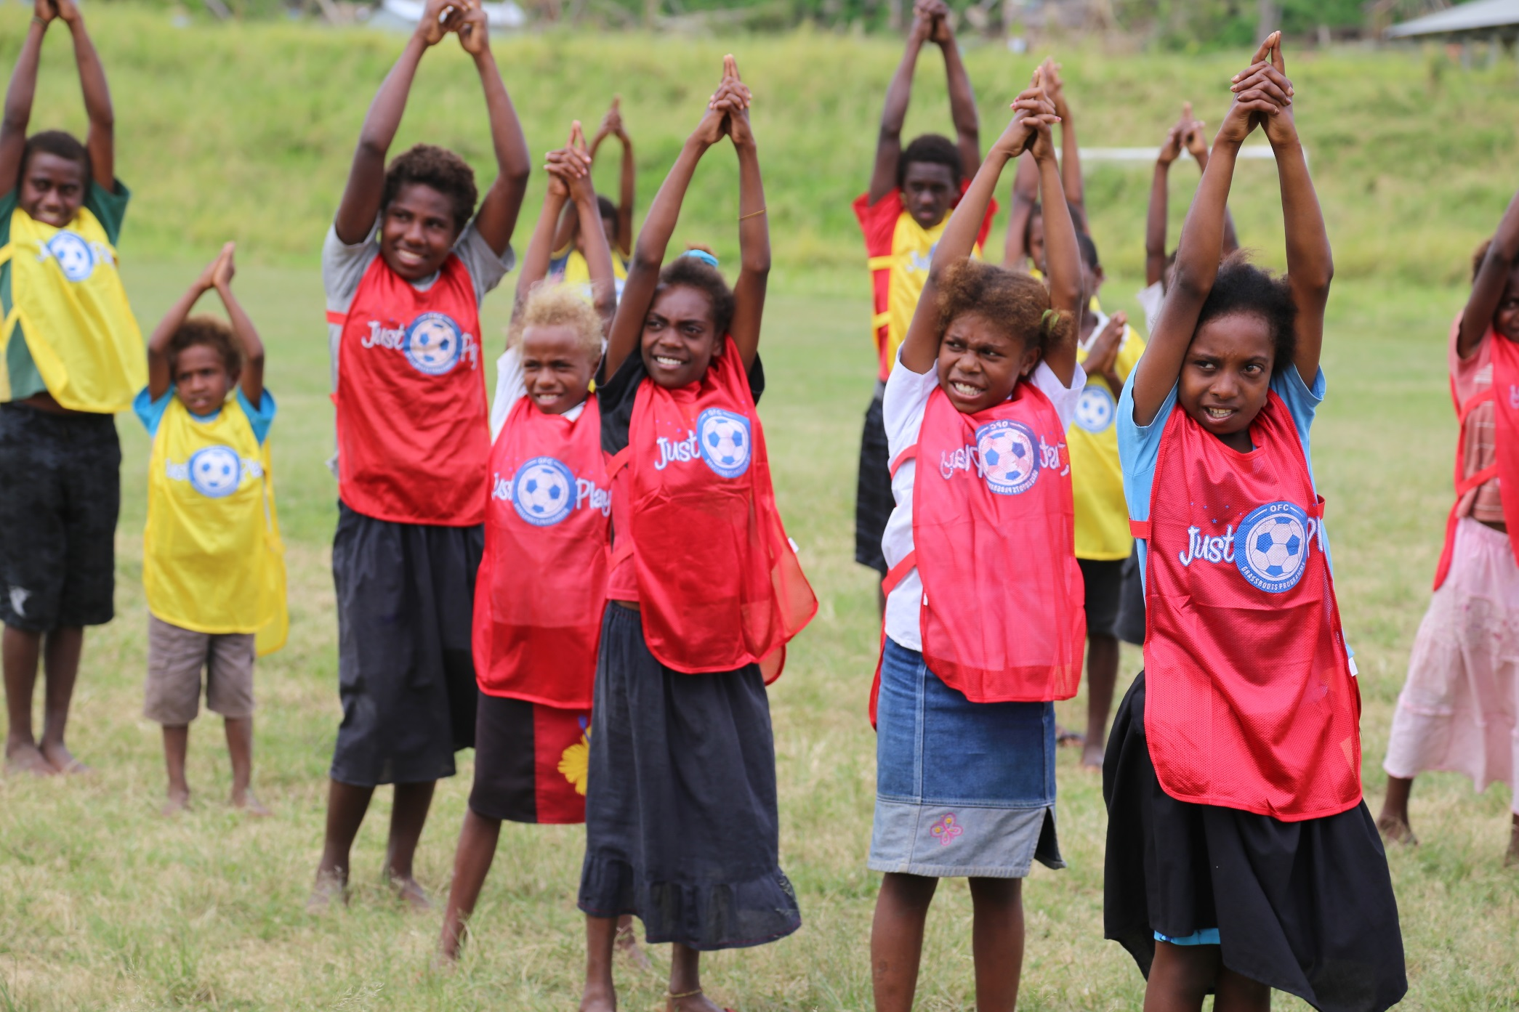
Tropical Cyclone PAM Response

Slide 13
Tropical Cyclone PAM Response
Targeted 14,000 children for re-issuing of birth certificates. 51,499 children were re-issued with birth certificates, 25,919 children were registered for the first time. A total of 80,251 children were reached.
Adults not initially targeted (Opportunity) – 175,157 adults were reached. 123,658 re-issued with birth certificates & 54,332 registered for the first time.
Recruitment of 3 provincial CRO officers.
Establishment of new registration points at provinces including at hospitals.
Provision of supplies such as computers, boats (2), vehicles (2), quade bikes (2). These supplies are now were sent to provincial offices to build resilience (preparedness).

Slide 14
Tropical Cyclone PAM Response
Register-VIZ data has been upgraded which enabled these functions:
Provide population information per community.
Enabled mobile registration.
Build in death notification system.
Additional security features.

Slide 15
Tropical Cyclone PAM Lessons Learned
Better planning required at national and provincial levels.
More resources required at national and provincial levels for data entry, printing, laminating & distribution of birth certificates.
Birth certificates takes longer than expected to reach the intended recipients.

Slide 16
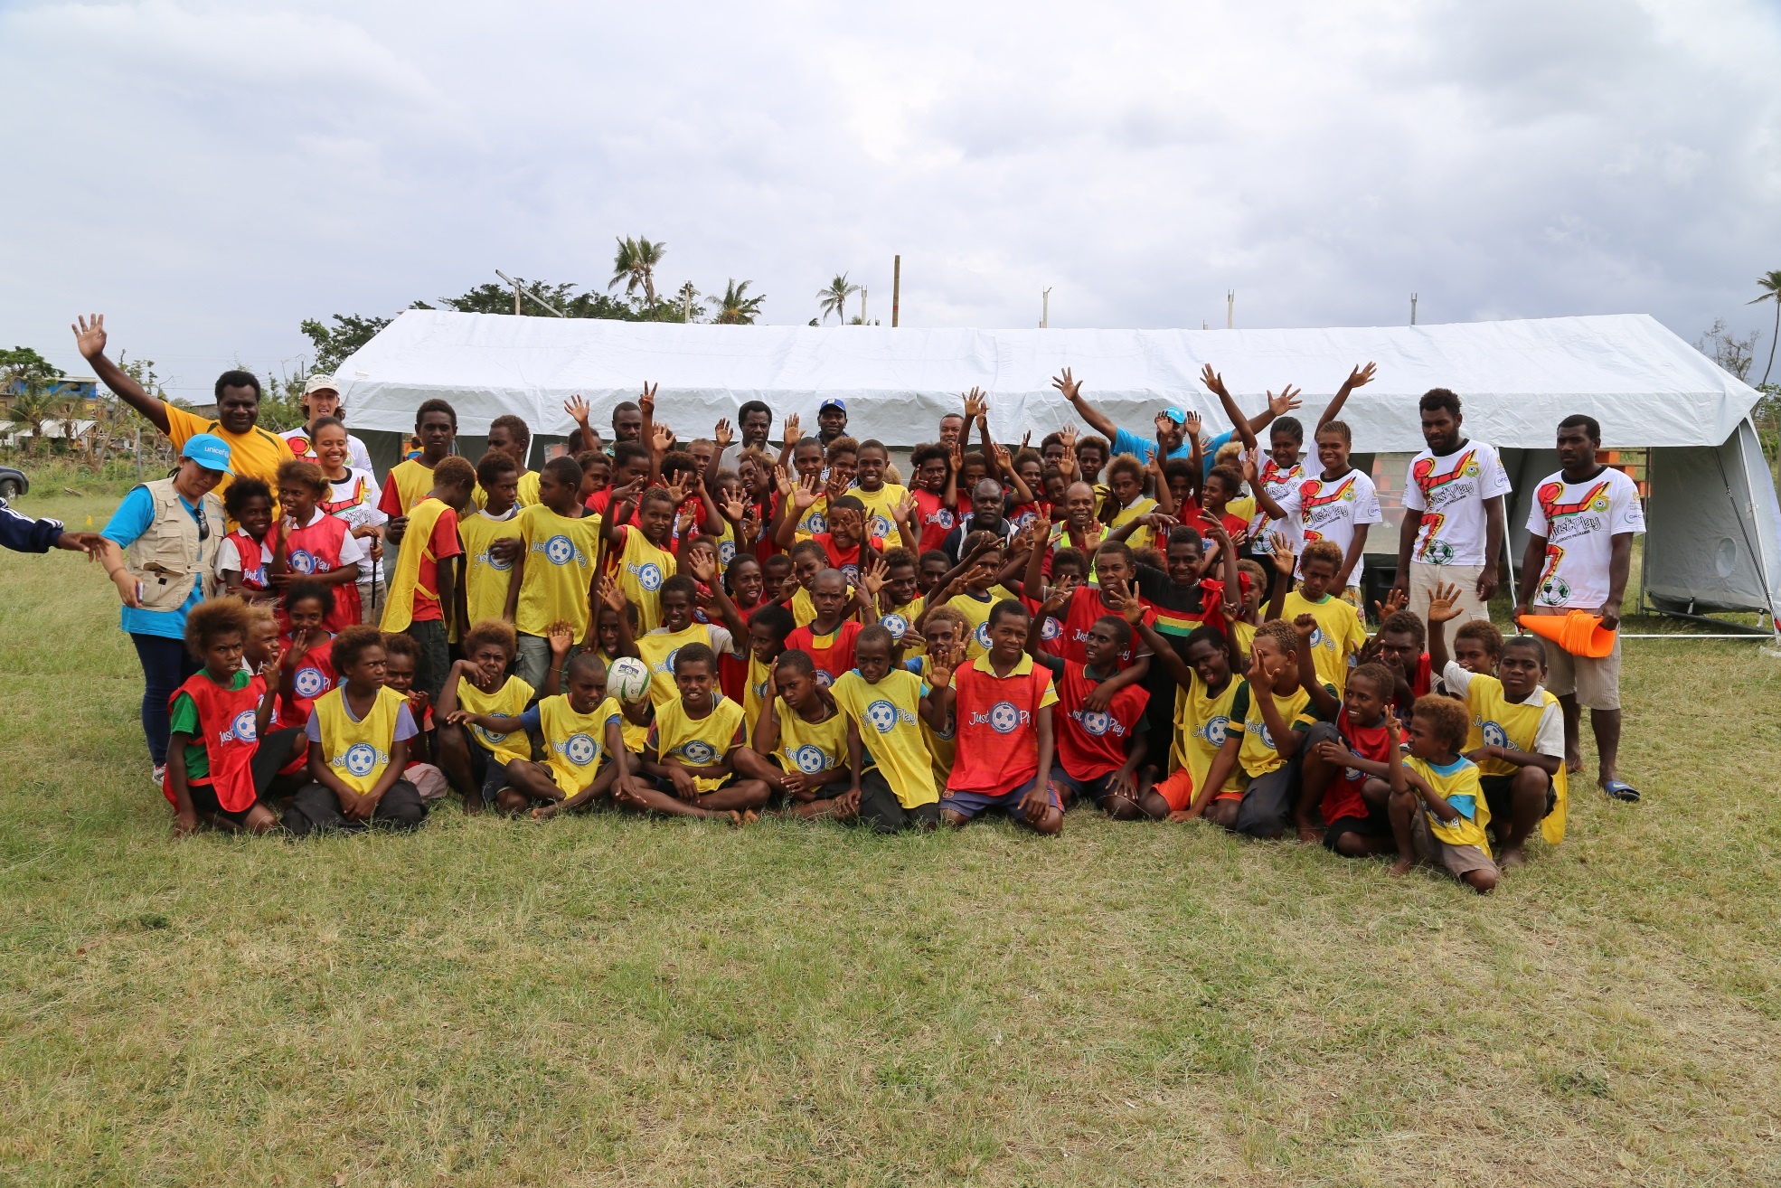
TANG YU TUMAS

